Slide 1
Agile Governance rule
Delivery Competency
Global Application Delivery Center
April 2017

Slide 2

Agenda
Background & Objectives
Review Process of Agile Development
Iteration (Sprint) Review Meeting
Operation Processes
Template
Roles & Responsibilities
Operation Scope
Challenges

Slide 3

Background & Objectives
Background
Agile methodology/practice is not yet well promoted in GIS.
There is not any governance rule for Agile projects execution.
Objective
To define iteration review to help Agile PJ to ensure Agile PJ process is well executed.
To define common DoD (*1) to reduce individual effort for DoD creation.
*1：DoD : Definition of Done

Slide 4
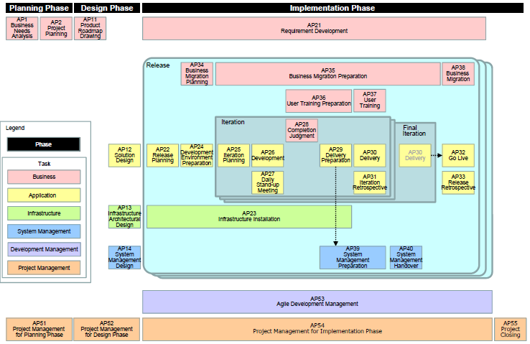
Review Process of Agile Development
Extracted from GCM
Iteration 1~n Review meeting
Sampling Check

Slide 5
Iteration(Sprint) Review Meeting
Time | PIC | Participation | Review Points | Template
1~2 Hours | Agile PMO & Dev. Team | (Required) RoC (Representative of Customer) (Required) Dev. Team (Required) Agile PMO (Optional) other stakeholders | Acceptance criteria which was defined by RoC DoD points defined at planning meeting by Agile PMO and Dev. team | Acceptance criteria list DoD list
Grey: out of governance scope as it should be reviewed by Product Owner.

Slide 6


Operation Processes
 | Delivery Competency | Biz Function GP/Technology Competency GP
 |  | Development team | Agile PMO | Representative of Customer | Other stakeholder
Start
Iteration planning meeting
Acceptance criteria list
DoD list
Target PJ
Recommendation
Target PJ
Define own DoD
RoC define acceptance criteria
Common
DoD list
DoD list
Meeting Preparation
(deliverables/invitation/documentation)
DoD list
Acceptance criteria list
Iteration
Review Meeting
Grey: out of governance scope

Slide 7
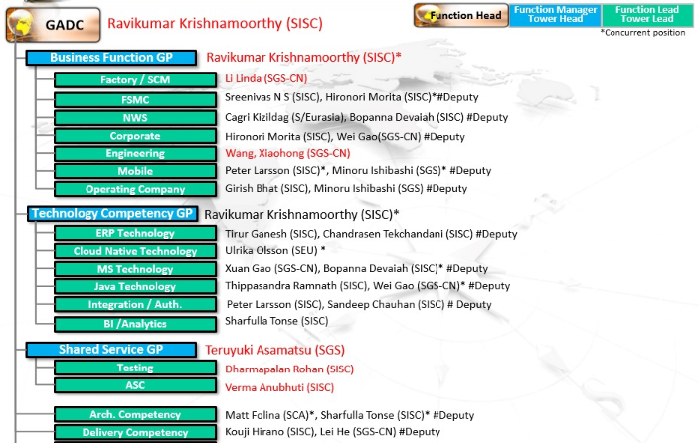
Operation Scope
In scope: Project/BAU belong to Biz Function Gp/Technology Competency Gp/Shared Service Gp/Arch. Competency/Delivery Competency
Out of scope: Initiatives in GADC planning/GADC Control and local sites

Slide 8
Roles & Responsibilities
Roles | Responsibilities
Representative of Customer | • Develop the requirements continuously while considering the changing needs of market and users. • Control the priority of implementation while communicating with development team. • Accept the system which is implemented at the each iteration. （similar to ‘Product Owner’ defined in SCRUM）
Development team | • Make the release plan and the iteration plan. • Develop and release the system according to the plan.
Agile PMO | • Support the Representative of Customer in requirements development. • Maintain and Improve the communication environment for Agile Development Group. • Maintain and Improve the development support tools for Agile Development Group. （similar to ‘SCRUM Master’ defined in SCRUM）
Extracted from GCM

Slide 9
Template

Slide 10

Challenges
1.How to collect Agile project information
-To confirm with GCOR
-To confirm whether we can get PJ information from each site
2.How to do sampling check for Agile project
-Join into review meeting, but need to know meeting arrangement

Slide 11
Appendix

Slide 12
Publication Method/Scope
Scope(GADC) | Governance Rule | Governance Result
Function Head | GADC Operation Committee Meeting (under confirming) | Mail
Function Manager Tower Head | GADC Operation Committee Meeting (under confirming) | Mail
Function Lead Tower Lead | GADC Operation Committee Meeting (under confirming) | Mail
Others | Mail | Mail
Explain Order

